Slide 1





The Benefits & Support of a WiN Champion and Lead
Benefits of being a champion
Benefits of being a lead
Exec level Mentor’s for champions or leads to support development & progression
Evaluating concepts for inception within Network
Opportunity to increase your exposure and learn new skills by working on projects and playing a key role in shaping activities and initiatives
Great opportunity to lead a team in progressing to the next stage in your career plan to becoming a manager
Continually looking for opportunities to share the benefits of the Network to encourage expansion
Work alongside your location manager(s) to cascade information to team members
Opportunities to lead projects and strategy that just are not available in the normal day to day role
Notes:
If you feel you would like to be more involved with the network then a great way to start is by becoming a Champion. You will have all of the benefits a Member has but you also will have the opportunity to work on projects and develop your skills and confidence.
Gain a development buddy through the SharePoint site, by finding someone who is an expert in an area you would like to develop, or just someone who shares your hobbies and passions.
Getting involved in strategic change that you wouldn’t normally be exposed to within your day to day functional role. Networking and collaborating with people from other functions to make change happen.
Using WiN as a stepping stone in your development and using it to fill some opportunity/experience gaps in your CV.

Slide 2
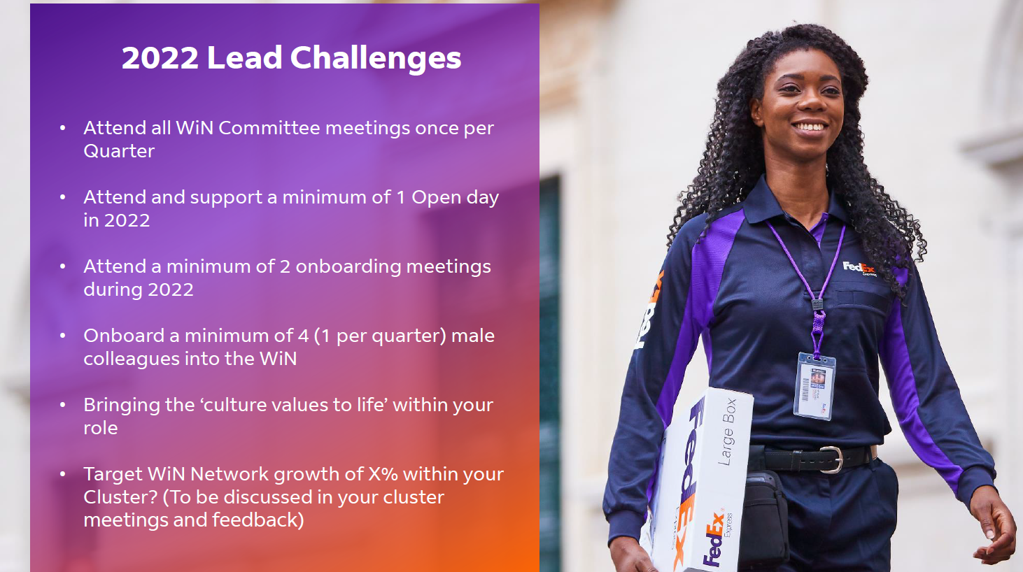

Slide 3


Slide 4
